Slide 1
Screening and Interviewing
Form 13614-C
Pub 4012 – 13614-C Job Aid
Pub 5101 – Intake/Interview And Quality Review Training
Notes:
This is the beginning of the journey to prepare an accurate, in-scope tax return
A short lesson, but very important to set the stage for probably the most important aspect of being an effective Counselor at the tax site.
Release 2 - -- Added a bullet to slide 10 to "Verify in scope"

Slide 2
Screening and Interviewing
IRS site reviews consistently recognizes that the interview process has been a significant weak area.
Deficiencies include:
  Failure to use the Intake Sheet (Form 13614-C)
  Failure to update the Intake Sheet when incomplete or when corrections are noted
  Little or no engagement with the taxpayer
  Failure to inform the taxpayer that the return is their responsibility

Slide 3
Objectives
Understanding how the Intake Sheet (Form 13614-C) should be used
Conducting an effective interview with taxpayer to confirm and correct information on Intake Sheet
Using effective interview techniques to probe and secure information to prepare a complete and accurate return
Notes:
Review lesson objectives.
State the presentation time.
Advise students what they learn in this lesson will be applied throughout the course.

Slide 4
Screening and Interviewing
Preparation of tax return does not begin until a thorough screening and interview has taken place!
  Form 13614-C – Intake Sheet completed, reviewed, and discussed with the taxpayer
  Ensuring return is in scope
  Probing questions to resolve tax issues
  Exercising due diligence
Notes:
Interview will avoid doing a lot of work, then finding out return is OOS or incomplete.
Each of the bulleted items are covered in the following slides in detail.

Slide 5
Engage the Taxpayer
Put taxpayers at ease
Be positive and friendly – build rapport
  Introduce yourself with a smile and a handshake
  Engage in small talk
This is not an adversarial relationship
Notes:
Remember – for some this will be a difficult, trying experience
Giving their personal confidential information to a stranger
Will they owe more than they can afford
Will they get the refund they hope for
May have physical limitations

Slide 6
Effective Interviewing
Speak clearly, simply, and loud enough
Reassure taxpayers (“I understand”)
Ask effective questions, i.e., probing and open-ended
Use active listening skills
Allow the taxpayers time to respond
Notes:
01CourseIntro 2010
6
Ask questions such as:
“Have you had any changes…”
“Tell me a little more about that”
Rather than just questions with Yes/No answers

Slide 7
Effective Interviewing (cont)
Let taxpayers explain in their own words
Paraphrase to show understanding
Don’t be afraid to say, “I don’t know – let me check”
Involve the taxpayers
Be mindful of the taxpayer’s privacy
Notes:
01CourseIntro 2010
7
Ask students how to build rapport. Answer: Reassure, i.e., “I understand.”
Ask students how to ask effective questions. Answer: Use Form 13614-C, probe, ask open-ended questions.
Ask students, What are active listening skills? Answer: Use nonverbal cues, allow time, restate, express empathy
Ask students how to overcome communication barriers. Answer: Involve taxpayers in the process; explain.

Slide 8
Explain The Steps
Review taxpayers’ situation – answer any questions – update the Intake Sheet
Organize supporting documents
Prepare the return
Initial review of the return
Quality Review
Wrap-up: print copies, signatures, etc.
Notes:
Make sure taxpayer understands the steps you will follow that lead to his/her return being completed
Review of I&I sheet and documents and last year’s return to make sure have everything and return is in scope
Data entry in TaxSlayer – will likely have questions as go through this
Your review of completed return with taxpayer – he/she knows better than anyone if spellings are correct, addresses correct, etc. plus chance to answer any questions
QR by a second set of eyes to make sure everything is correct
Will give copies of returns to taxpayer for their records
Will efile federal and state returns (unless there is a tax law related reason not to – we don’t prepare paper returns otherwise)
Will give them any local returns to mail if necessary

Slide 9
IRS Intake/Interview Sheet –
Form 13614-C
Required starting point for taxpayers – complete Form 13614-C
  Basic information counselor needs to assist in the preparation of the tax return
  Taxpayers fill out, but volunteers may need to assist
Counselor’s starting point with taxpayers
Notes:
This is not an option – REQUIRED for each taxpayer/couple/family
Some taxpayers may have difficulty answering all the questions.
Client Facilitator (if you have one) can help
You will help as you review all questions and entries

Slide 10
IRS Intake/Interview Sheet –
Form 13614-C
Before starting return, volunteer should:
  Make sure all questions on 13614-C have been answered by the taxpayer
  Change “Unsure” answers to “Yes” or “No” based on answers to interview questions
  Verify that the return is in scope
  Verify return is within volunteer’s certification and training level
  Complete those areas that are the responsibility of the volunteer (gray shade)

Slide 11
Note…
If the site has a Client Facilitator, he/she can ensure that Intake Sheet is completed before release to Counselor
Counselor must still
  Review entire sheet with taxpayer
  Ask appropriate questions to verify accuracy of all information
Notes:
Not all sites have CFs
Counselor must still verify everything

Slide 12
First Step – Screen for Eligibility
Confirm identity of taxpayers with photo ID
  LC approval required for exceptions, should be very rare
  Personal verification of ID by counselor
Confirm Social Security or other taxpayer identification number for every person listed on the return
Notes:
Be cognizant of IDENTITY THEFT!
Screening may be done initially by the client facilitator, but the trained counselor must ALSO complete this step.
If taxpayer and spouse are known by counselor and identity can be verified by counselor, that is acceptable.

Slide 13
Taxpayer Identification Number
Best – Social Security card or ITIN (Individual Taxpayer Identification Number) letter
Alternatives
  Other documents issued by Social Security Administration such as SSA-1099 or Social Security Administration letter -OR-
  A review of the taxpayer’s copy of last year’s return
Notes:
Must have photo ID – Exceptions by LC in “Extreme Conditions”.
Alternates for SS Verify – Income Statements (1099-SSA), Letters from SS or other SS documents. Medicare card with suffix A
Most Social Security documents will no longer contain full SSN. If not a carry-forward or taxpayer does not have last year’s return, check with local coordinator for policy.

Slide 14
Screen for Eligibility
Review Intake Sheet for any out of scope items
Sort taxpayers’ documents for sources of income and expenses
  Note: verify tax year
  Review for any out of scope items by using the AARP TaxAide Scope Manual
  Begin interview process
Notes:
The counselor’s job is not just to input the taxpayer’s documents – it is to ensure they are preparing an accurate and complete tax return for the customer.
Not uncommon for taxpayers to mix multiple years of documents, so be sure have this year’s
Sort in Form 1040 order and leave in order so that QR person doesn’t have to hunt

Slide 15
The Interview Process
Stress to taxpayers that
  It’s their return and they are responsible for accuracy of all data provided
  They must have accurate and complete records if audited by IRS
Review Intake Sheet and confirm/clarify all Yes, No or Unsure answers
Notes:
Starting point is generally to believe the taxpayer.
But, taxpayers must understand that it is their return and that we are only helping them prepare and file it.
Obtain information from the taxpayer that will enable the volunteer to change unsure answers to yes or no.
They need to be told (sometimes more than once) that we will enter the data that they provide to us, but in the event of an audit, they will need to provide records and other information to substantiate their claims on the return.

Slide 16
The Interview Process
Update Intake Sheet with all missing or corrected information
Use the Intake Sheet to guide your discussion with the taxpayer
Add notes on Intake Sheet during interview to help Quality Reviewer determine if return is accurate
Notes:
Starting point is generally to believe the taxpayer.
But, taxpayers must understand that it is their return and that we are only helping them prepare and file it.
They need to be told (sometimes more than once) that we will enter the data that they provide to us, but in the event of an audit, they will need to provide records and other information to substantiate their claims on the return.

Slide 17
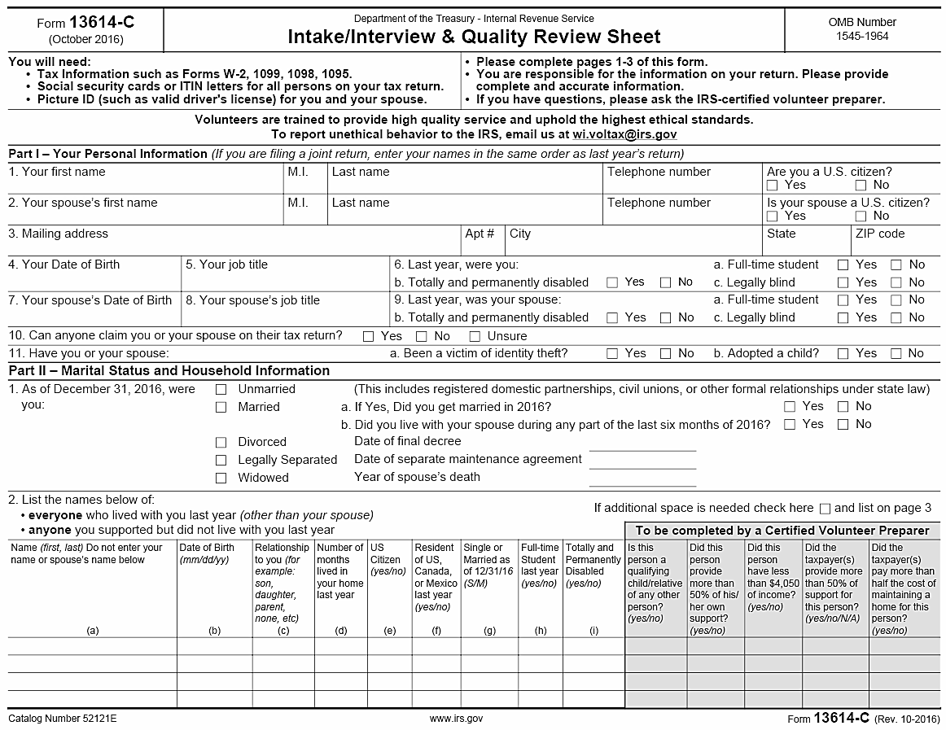

Slide 18
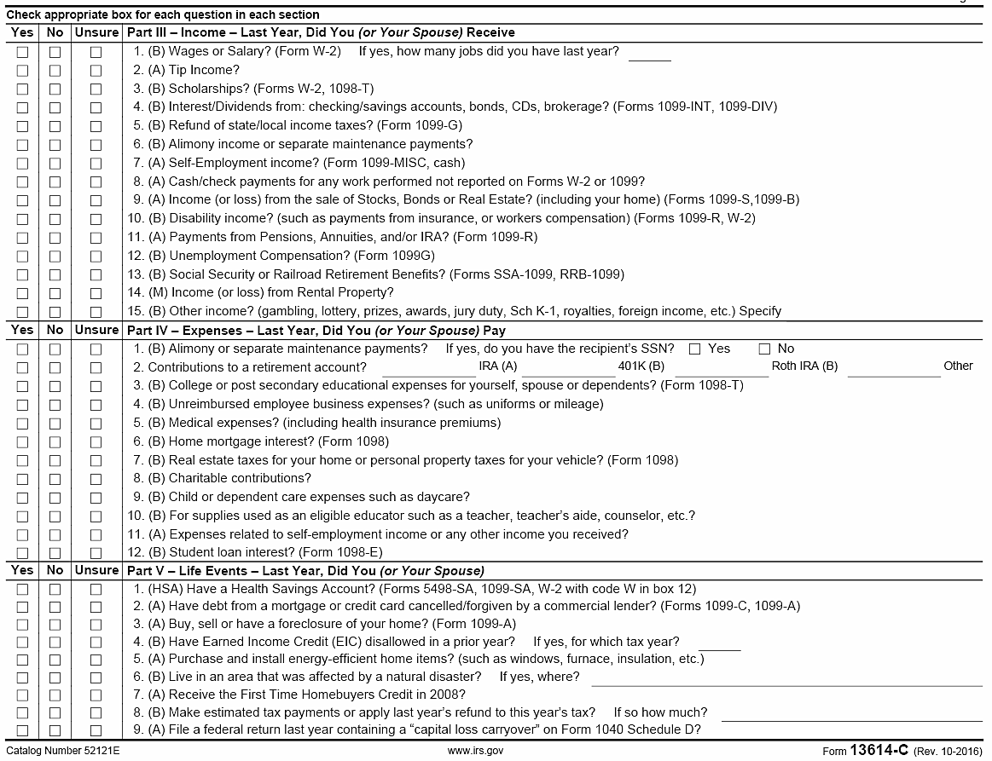

Slide 19
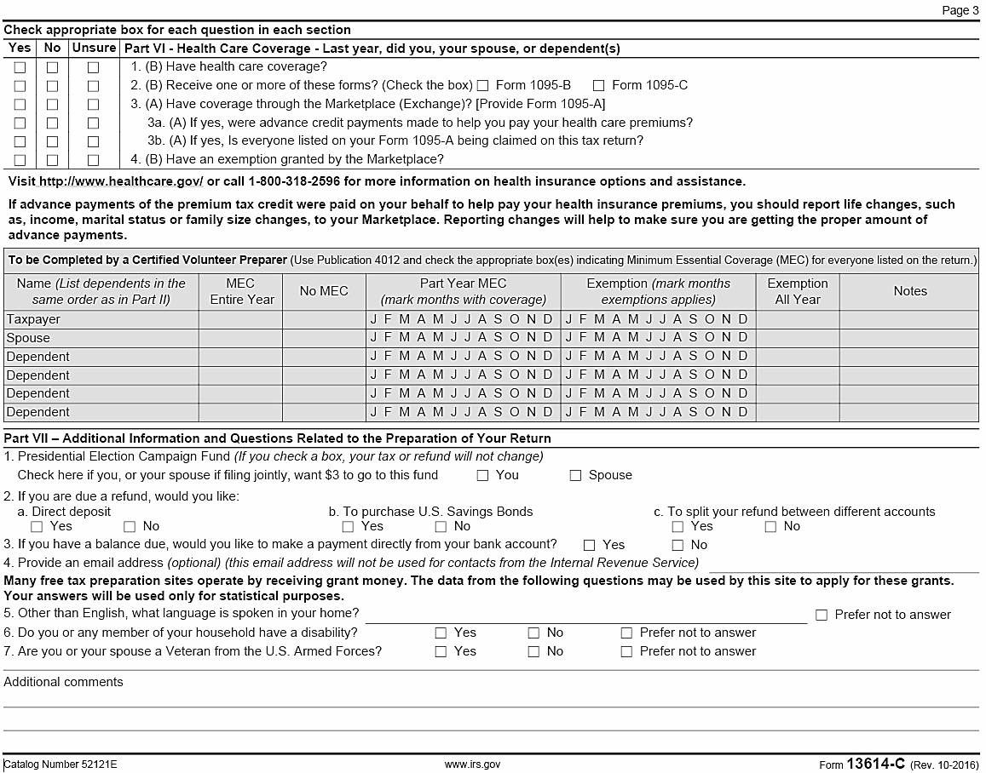

Slide 20
Probing Interview Techniques
Engage taxpayers in a conversation to clarify their answers and identify other tax issues that may affect tax return
Verify any issue that is not clear, ask more questions until you are satisfied you have all the facts
Notes:
20
Sometimes it’s not enough just to ask their filing status; taxpayers must be asked appropriate questions so that you are confident the filing status is correct. It may appear you are prying, but these questions are needed to file an accurate return.
Refer to sample interviews in PUB 4491, Lesson 2.

Slide 21
Probing Interview Technique
Verify and clarify information which appears to have changed from last year’s tax return
Verify that taxpayer has all needed documents – do they reflect the answers on the Intake Sheet?
Verify accuracy of documents and receipts
Use due diligence

Slide 22
Due Diligence Is…
Asking sufficient and thorough questions to ensure accuracy and completeness of tax return -AND-
Verifying accuracy of documents presented OR determining when to rely on, in good faith and without verification of, taxpayer’s oral/handwritten testimony -AND-
Ensuring a second person quality review
Notes:
22
Counselors must exercise due diligence in preparation of tax returns.
IRS defines due diligence as the return preparer ensuring the correctness of oral and written representations made by the taxpayer.
The preparer must make reasonable inquiries if the information furnished appears to be incorrect or incomplete.

Slide 23
Due Diligence (cont)
Counselors must ask questions if information furnished appears to be incorrect, inconsistent, or incomplete
Counselors may not ignore information furnished to, or actually known, by him/her
Counselors must not KNOWINGLY prepare false returns!
Notes:
23
The bell can not be unrung.
If taxpayer tells counselor about income, it must be reported. For example:
Cash for self-employment work
Interest on checking account not reported on 1099-INT

Slide 24
Due Diligence (cont)
If during interview, Counselor becomes concerned with accuracy of taxpayer’s documents or answers – should consult with Local Coordinator
Counselors should not prepare return if are uncomfortable with results of interview with taxpayer
Notes:
24
The bell can not be unrung.
If taxpayer tells counselor about income, it must be reported. For example:
Cash for self-employment work
Interest on checking account not reported on 1099-INT

Slide 25
Relying on Good Faith
Good Faith is relying on oral/ handwritten testimony from taxpayer that is ordinary, necessary and reasonable
  Taxpayer has established credibility – a returning taxpayer who has forgotten to bring a receipt
  The dollar amount is insignificant
Notes:
Remind taxpayer (again) that they be able to provide records if IRS or state asks for them

Slide 26
After the Interview: Four Options
Begin to prepare taxpayer’s return
Advise taxpayer to bring missing documents another day; help set up an appointment
Hand off to another Counselor if not in your “comfort zone” or within your training
Advise taxpayer that return is out of scope and why
  Discuss situation with Local Coordinator/other Counselors first
  Return intake sheet and all other documents to taxpayers
Notes:
If not comfortable with some in-scope tax situation, hand taxpayer off to more experienced counselor.

Slide 27
Intake/Interview & Quality Review Test
All Local and Shift Coordinators and Counselors must pass test
All Client Facilitators must pass test
Ten Questions
Test questions in Form 6744
Pub 5101 provides training materials for self-study

Slide 28
Quiz #1
The taxpayer marked question on interest as “unsure”
Upon questioning taxpayer responds that did receive $6 as shown on their bank statement
What do you do?
Change answer to “Yes” and record the $6 on Intake Sheet to alert Quality Reviewer about interest

Slide 29
Quiz #2
A taxpayer says he/she is self-employed, but only documentation is some poorly handwritten notes and his/her answers during interview are inconsistent and evasive
What do you do?
Discuss situation with your Local Coordinator. You do not have to prepare a return if you are uncomfortable with the results of your interview

Slide 30
Quiz #3
A taxpayer does not have photo ID with them, but you know them personally
What should you do?
Talk to your Local Coordinator who can approve an exception to the rule, especially since the taxpayer is personally known to you

Slide 31
Quiz #4
A taxpayer does not have Social Security cards for two dependents but did bring a copy of last year’s return that was completed by a paid preparer
What do you do?
Discuss situation with Local Coordinator to determine if can use a copy of last year’s return to confirm social security numbers

Slide 32
Screening and Interviewing
Questions…
Comments…

